Slide 1
Kings County:
How do I increase the Value of my Home?
By: Tim Mango and Pablo Salcedo

Slide 2
Data Cleaning and Exploration
Variables with null values
Waterfront View, Year of Home Renovation, Home View Grade.
Basement Square Footage had “?” values.
Correlation with target variable
Home Price showed strong correlation with the variables Number of Bedrooms, King’s County Grade, Home Square Footage, and Number of Bathrooms.
Price and King’s County Grade had negative correlation with Home Condition.
High level of inter correlation among several explanatory variables.

Slide 3
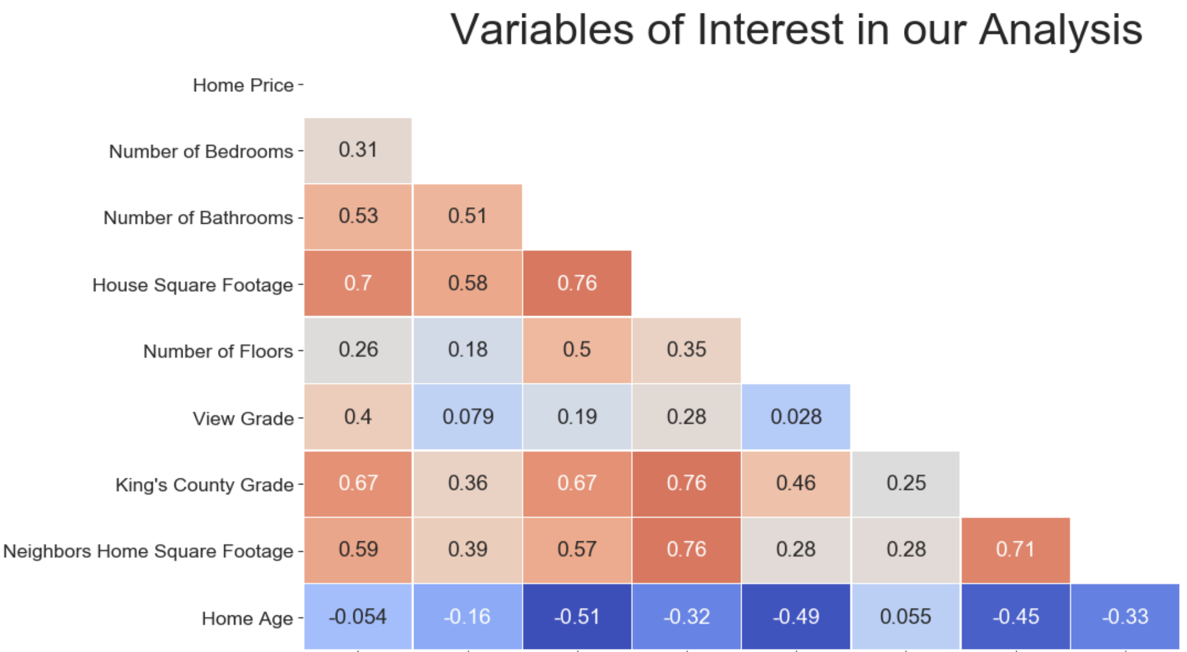
King’s County Grade
The overall grade given to the housing unit, based on King County grading system.
Neighbors Home Sq. Footage
The square footage of interior housing living space for the nearest 15 neighbors.
Home Age
The number of years since
the year of home construction.
View Grade
Grade of scenic view from
home(0-4).

Slide 4
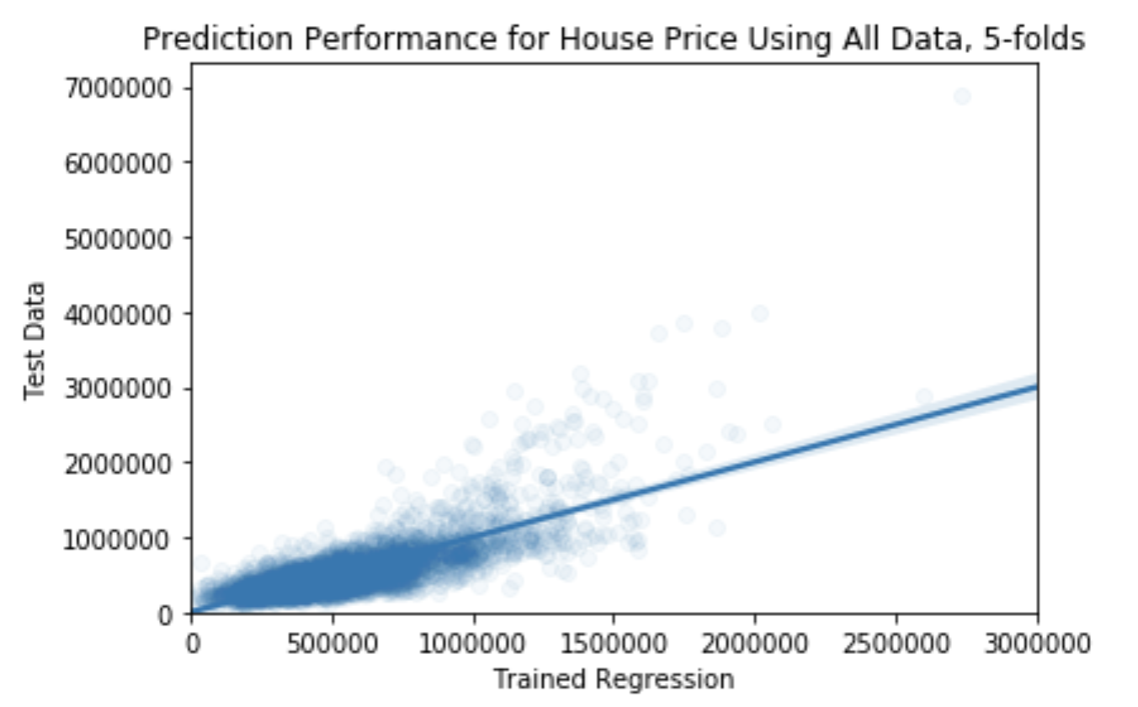


Slide 5
Linear Regression Model
Variable Name | Significance Level
Home Square Footage | 0.01***
Number of Bathrooms | 0.01***
Number of Floors | 0.01***
King’s County Grade | 0.01***
Neighbor’s Sq. Footage | 0.01***
Home Age | 0.01***
View Grade | Relevant
Zip Code | Relevant
R-squared: | 0.819

Slide 6
Tested Model
Our housing price prediction missed by an average of $83,079.
93.1% of rows kept. Analysis has 79 variables with 20,107 rows, no missing values.

Slide 7
Conclusion
Model Variable | Regression Coefficient
Home Square Footage | $89.10 per square foot
Number of Bathrooms | $10,483 per bathroom
King’s County Grade | $46,443 per increase of house grade in King County grading system
Neighbor Home Square Footage | $38.10 per square foot increase in average neighbor’s home
Best View | $173,643 additional home value compared to worst view home.

